Slide 1
research and poverty
How Research Can Overcome Poverty and Vulnerability, From Birth to Old Age

Slide 2
Poverty in Indonesia has halved in the last 15 years, but reduction is slowing as the remaining poor
are harder and harder to reach
Poverty Headcount Rate in Indonesia
Global Food and Fuel Crisis
Asian Financial Crisis
Global Financial Crisis

Slide 3

Moreover, much of the population lives
just above the poverty line…
Indonesian Consumption Distribution, 2011
Official Poverty Line = Rp.233,700/person/month
1.5 x Official Poverty Line
40% of Indonesians live below 1.5 times the official poverty line
Source: BPS, Susenas

Slide 4
…and remains vulnerable to shocks
Poverty status in 2009
of those poor in 2010
Number of times poor
2008-2010
26%
55%
More than half of poor households in 2010 were not poor in 2009
One in four Indonesia households were poor at least once in a three year period

Slide 5
Slowing poverty reduction means greater efforts to promote the chronic poor out of poverty are needed
High vulnerability and transient poverty means greater efforts are needed to protect the vulnerable
Protection and promotion mean addressing opportunities and risks at every point of the life cycle

Slide 6
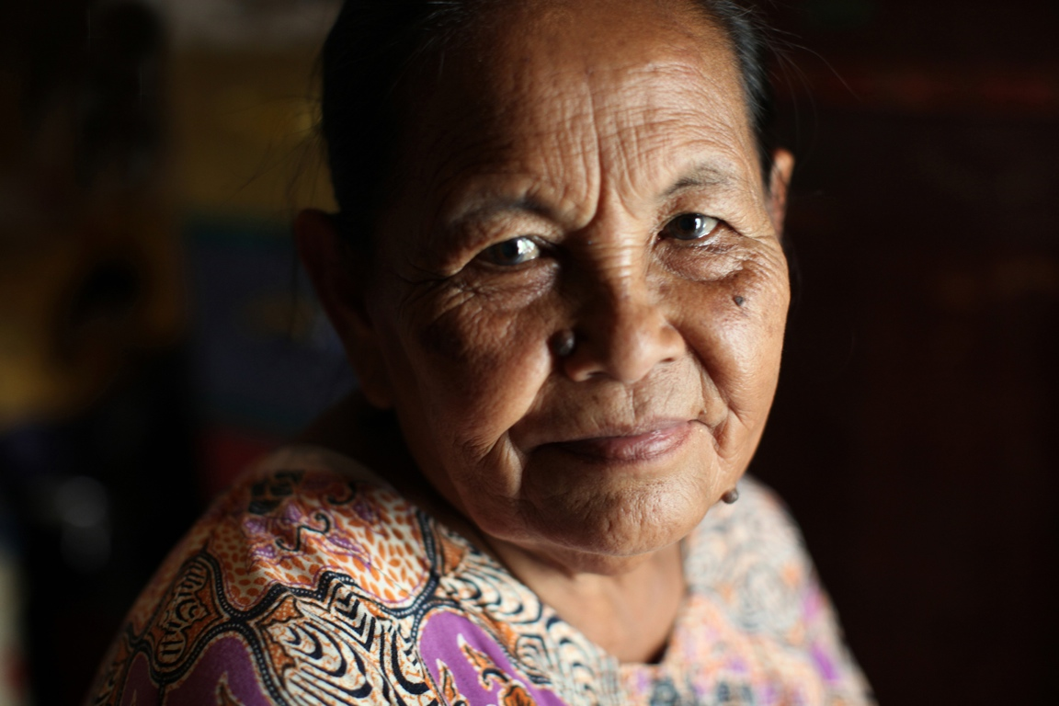
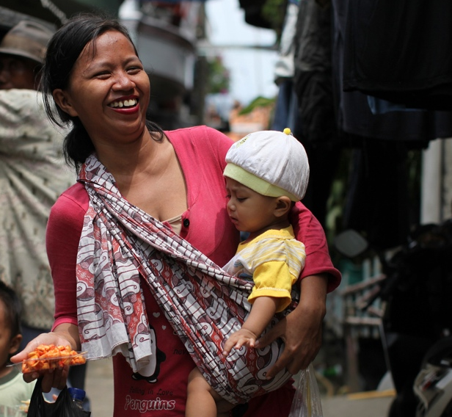
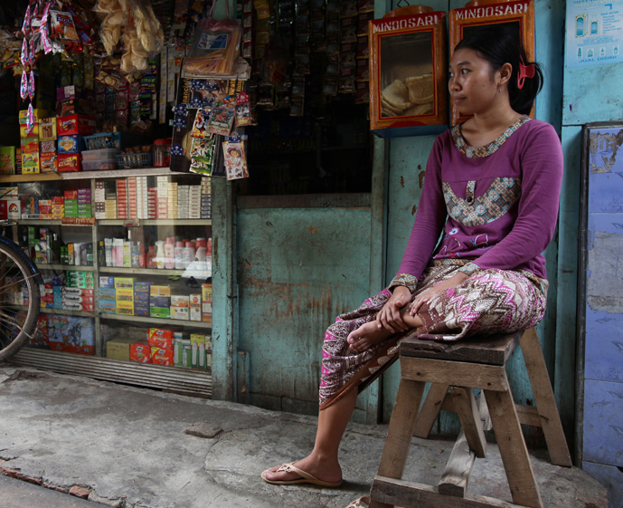

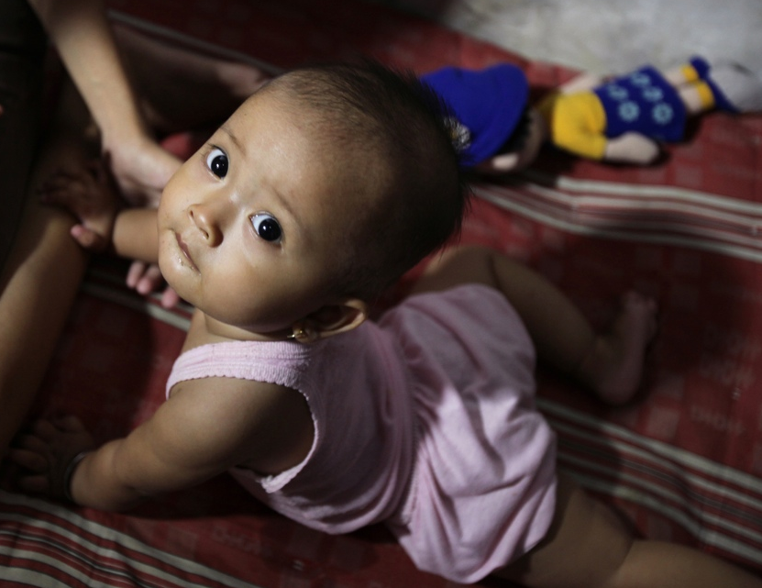
old age
family
work
school
birth

Slide 7

birth
promotion
protection
raising healthy infants and children
children being born with low birth weight
infant mortality rates (lowering, but still high)
using the golden age (utero, and from 0-2 years) to lay the foundations for later life
stunting resulting from poor nutrition
Notes:
Research shows that the most important periods for cognitive and physical development are in utero and from 0-2 years old.
Making the most of this period maximises adult health, education and income.
Low birth weight leads to malnutrition and child mortality. It also means poorer health and reduced cognitive development now and later in life.
Growing properly as an infant and a balita means having enough calories to eat, but also the right balance of nutritients.
Mental and social stimulation from an early age have been shown to be important for a child’s cognitive development.

Slide 8
birth
Indonesia’s child malnutrition rate is 5 times higher than Thailand
Source: World Development Indicators
Notes: Cambodia, Indonesia, Myanmar (2010); Philippines, Vietnam (2008); Malaysia, Thailand (2006)
Prevalence of child malnutrition is the percentage of children under age 5 whose height for age (stunting) is more than two standard deviations below the median for the international reference population ages 0-59 months. For children up to two years old height is measured by recumbent length. For older children height is measured by stature while standing. The data are based on the WHO's new child growth standards released in 2006.
Notes:
Add notes on stunting figures or graphic
Child mortality decreasing but still high

Slide 9
birth
Questions for Research
how can we continue the improving trend in child mortality?
if we know how to address malnutrition, why is it still so prevalent in Indonesia?
Notes:
Add notes stunting: some possible solutions:
The 2008 Lancet Series on Maternal and Child Undernutrition identifies interventions
that prevent early-life stunting including: improved maternal nutrition (stunting starts in-
utereo), exclusive breastfeeding, complementary feeding, multiple micronutrients,
iron folate for mothers, immunizations and sanitation/hygiene interventions.
The Government of Indonesia is committed to supporting national policies to reduce the
incidence of childhood stunting and improve sanitation standards by 2014 (RPJM 2010-
2014 targets reducing stunting from 36.8 to 32 percent)
However, supply constraints undermine greater improvements in health outcomes,
including reductions in childhood stunting and low birth weight.

Slide 10
school
promotion
protection
students are able to transition to higher grade levels
risk of early drop out due to:
high out-of-pocket school costs
no school nearby
high opportunity costs
quality of education prepares students for decent jobs

Slide 11

school
Over 80% of the poorest students drop out before reaching grade 10
Final Education Attainment by quintile, 2010
(26-28 year olds in 2010)
Richest quintile
Poorest quintile
Notes:
PISA quality , and sentence of not enough school,

Slide 12
school
    Over ¾ of students perform at or below the “low” level in TIMSS in math
    No students perform at advanced level
TIMSS 2011, Math results
Share of students at each level
Source: TIMSS 2011
Notes:
PISA quality , and sentence of not enough school,

Slide 13
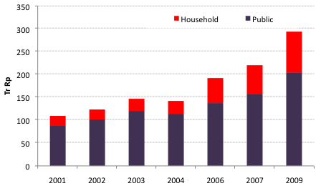
school
The reliance on out-of-pocket household spending in SMU and HE is very high
Source: Public spending from MoF and SKID, Household spending from Susenas, core module
Notes:
PISA quality , and sentence of not enough school,

Slide 14
school
Questions for Research
how do we increase transition to junior and senior secondary school for poorer students?
how do we improve the quality of education?
why is uptake of scholarships low, and how do we improve this?

Slide 15
work
promotion
protection
job loss
workers are able to find “good” jobs (decent income, high productivity, social protection)
crop failure
entrepreneurs are able to scale up their businesses
accidents and injuries at work
workers can improve their skills sets to find better jobs

Slide 16
in a highly informal labor market, the quality of jobs for most workers is low
work
The majority of workers are in the informal sector
Over 80 percent of formal workers do not have a contract.
Employees without contracts earn less and are less likely to receive any benefits.
Source: Statistics Indonesia (BPS)

Slide 17
productivity is low because the vast majority of Indonesia’s firms are small
work
Source: World Bank, Enterprise Survey, 2009

Slide 18
youth unemployment is high compared to regional neighbors
work
Tingkat pengangguran kaum muda (% dari angkatan kerja berusia 15-24)

Slide 19
work
Questions for Research
what are the main barriers to the creation of “good” jobs in Indonesia
why do firms and unions underinvest in skills training?
What causes the glass ceiling on firm size, which prevents the growth of medium and large firms?

Slide 20
family
promotion
protection
mothers have a safe childbirth
healthy mothers having healthy children
children do not die at birth or infancy

Slide 21

family
Mothers in Indonesia are almost 10 times more likely to die after childbirth than in Malaysia
Indonesia
Brazil
China
Malaysia

Slide 22
family
Questions for Research
why do so many Indonesian mothers not use have skilled birth deliveries, especially given wide access to midwives?
what else can be done to reduce Indonesia’s high maternal mortality rates?
do parent training services work? how can they be most effective?
Notes:
25 percent of all births do not use skilled delivery, but instead use traditional helpers
Skilled delivery means that problems during and after birth can be quickly diagnosed and treated. This means less mothers and children die.

Slide 23
old age
promotion
protection
disease and complications related to age
everyone can enjoy their retirement, with enough income and good health
loss of income for old age workers
inability of family to take care of aged members

Slide 24
old age
Indonesia is running out of time…
the demographic bonus will reverse by 2030

Slide 25
old age
Questions for Research
what are the best ways to extend social security to today’s informal workers and tomorrow’s elderly?
what is the right balance between protection and fiscal sustainability?
what are the key challenges facing the disabled in Indonesia, and how do we address them?

Slide 26
constraints to exiting poverty and increasing welfare
MAMPU
MAU
information
TAHU
having the resources to do what needs to be done
incentives
willing to do what needs to be done
resources
knowing what to do

Slide 27
tahu
mau
mampu
do not know of exclusive breastfeeding
belief in traditional rearing methods
ECD and parenting education rare
birth
do not know the importance of education
opportunity cost of child’s time
not available,
not affordable
school
do not know what jobs are available
available jobs lack stability and security
job creation issues not being addressed
work
do not know what constitutes an emergency
culturally dependent on dukun
Supply side issue,
not affordable
family
old age
do not know how to prepare for old age
reliance on moral economy
contributions not affordable

Slide 28
Some big picture research questions
that go beyond the life cycle…
what are the main barriers preventing poor households from entering the middle class?
what are the main sources of household risk and vulnerability, and how do households cope?
are recent reforms in social assistance leading to adequate protection, or is more needed?
do greater investments in social protection undermine traditional social capital?
what are the drivers of increasing inequality, and what policies can promote shared prosperity?

